Slide 1
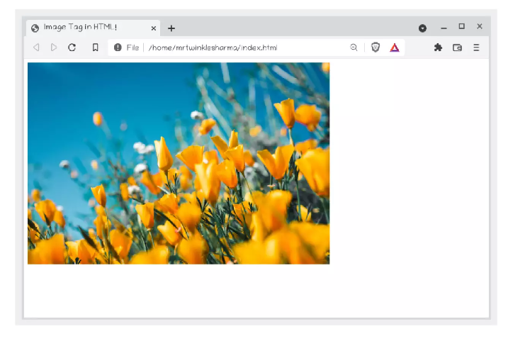
Adding Images

Slide 2
Adding Images
A picture is worth 1000 words as they say.
I think you will agree that a website without pictures wouldn't provide a very good user experience. Especially websites about food.
My example website about “Little Lemon” could certainly use a few images.

Slide 3
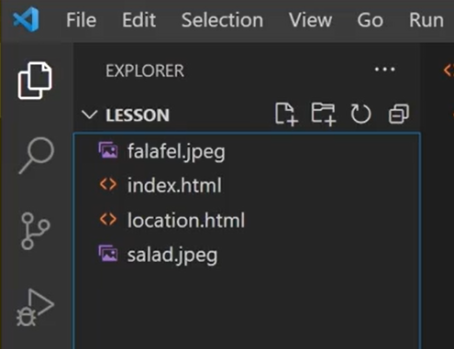
Adding Images
In this lecture you will learn how to add images to HTML documents using the image or IMG tag as it is commonly known.
I have two image files in my project folder, one name falafel.jpeg and another named salad.jpeg.
Similar to what I did with document links, I have to
specify the link to the image file using the image tag.

Slide 4
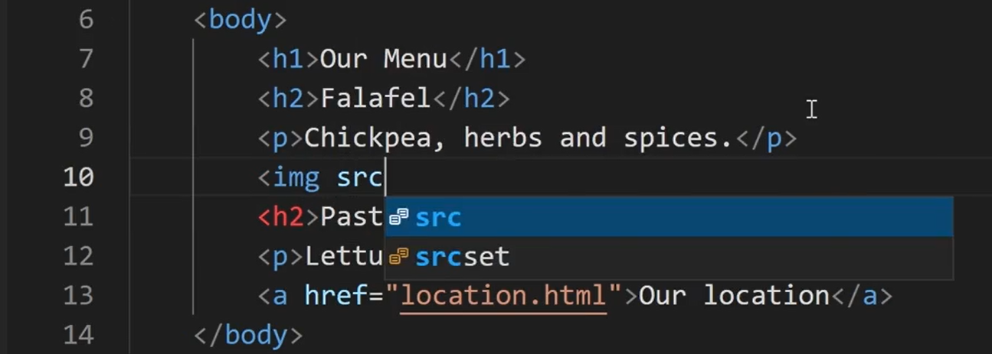
Adding Images
Images are not inserted into web pages. Instead we use image tags in HTML to link to image files.
The image tag then creates a placeholder for the image on the web page. To add an image tag, I type <img> and inside it I add the “src” attribute or source attribute as it is known.

Slide 5
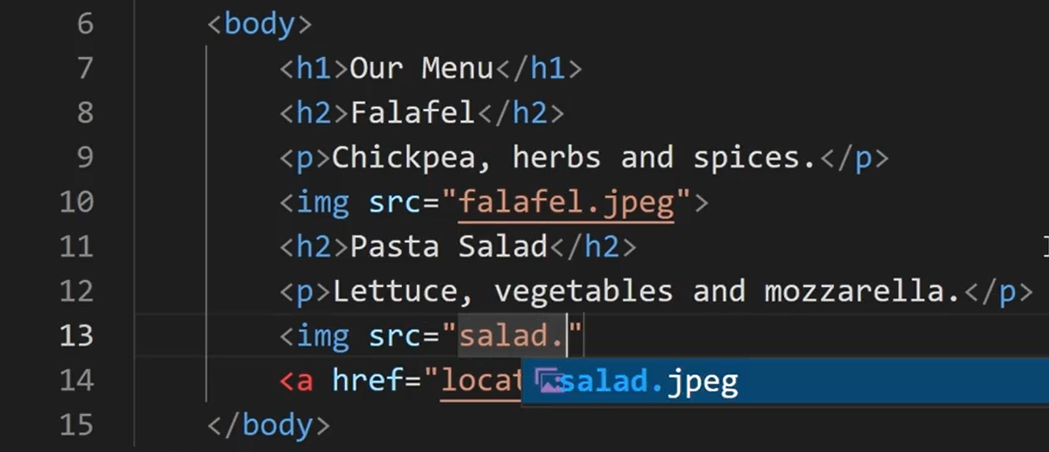
Adding Images
I type “falafel.jpeg” as a source for one image, and “salad.jpeg”, as a source for the other image.
Let's save the file and open it in the web browser.

Slide 6
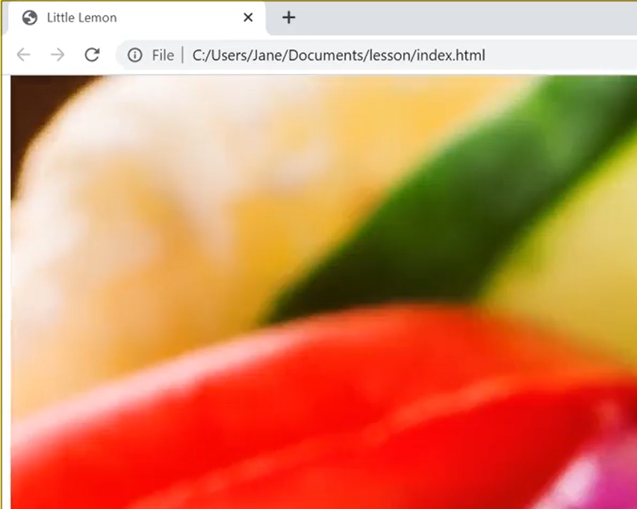
Adding Images
The images are displayed but they are way too big.

Slide 7
Adding Images
Luckily there are several ways to set the size of an image but in this lecture I will just demonstrate how to do this in HTML.
Right after the sourcing in the image tag, you can specify the dimensions of an image.
I first add the “width” attribute, and set it to 240 pixels and then I add the “height” attribute and set it to 135 pixels.

Slide 8
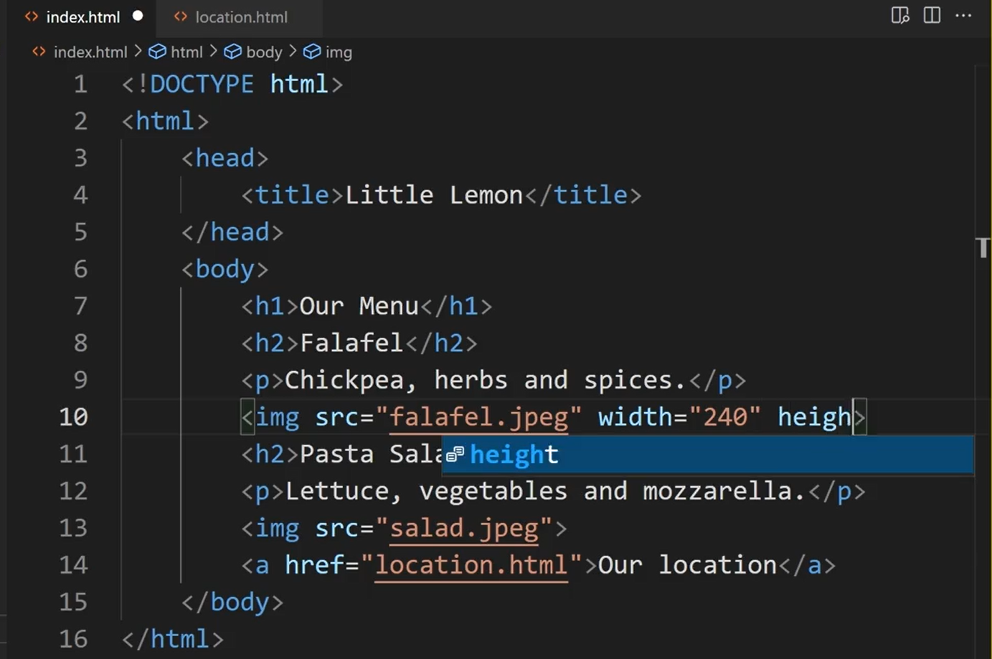
Adding Images

Slide 9
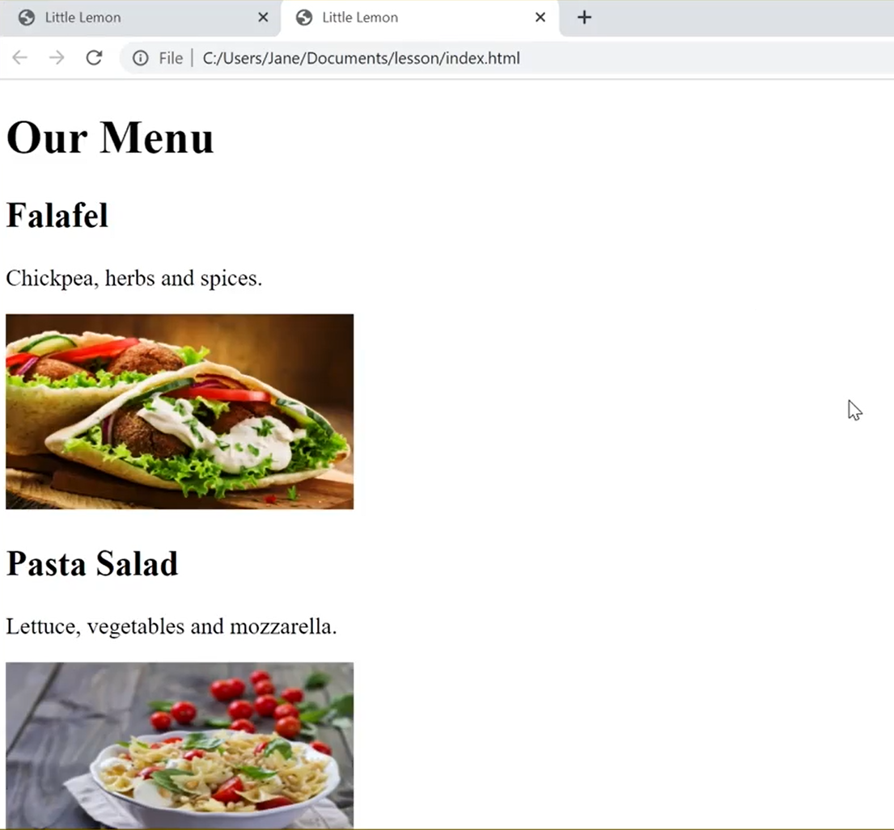
Adding Images
I'll set the other image to the same dimensions.
Let's save and view it in the browser again.
Much better, the images are smaller now.

Slide 10
Adding Images
But there is one important attribute that you should always include with image tags.
It is good practice to add a short description for images.
It helps improve accessibility for people using assistive technologies and it can also improve search engine rankings.

Slide 11
Adding Images
You can add image descriptions with the alternative text attribute also known as the “alt” attribute.
Still within the image tag after the dimensions attributes you can add the “alt” attribute.
I will type a short description, “A falafel” and for the other image I will type, “A pasta salad”.

Slide 12
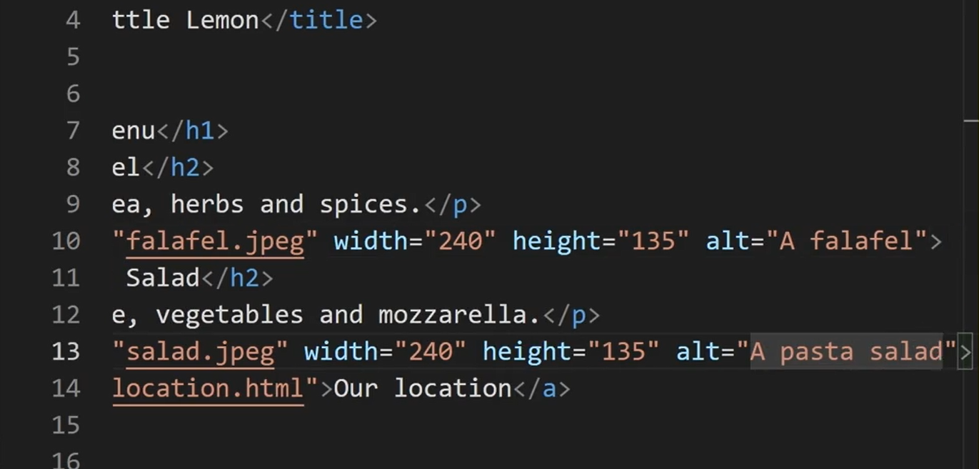
Adding Images

Slide 13

Adding Images
I will save the Html file again and open it in the web browser.
The “alt” text is not displayed anywhere on the site but will be read by assistive technologies such as screen readers.

Slide 14
Adding Images
Screen readers and other accessibility tools use the altar tribute to provide information to their users.
Now you know how to add images to websites with the image tag.
Little Lemon website is now ready for everyone who uses the web.
Have fun while you make your sites colorful by adding images

Slide 15
Additional Resources
Learn more Here is a list of resources that may be helpful as you continue your learning journey.
HTML Elements Reference (Mozilla)
https://developer.mozilla.org/en-US/docs/Web/HTML/Element
The Form Element (Mozilla)
https://developer.mozilla.org/en-US/docs/Web/HTML/Element/form
What is the Document Object Model? (W3C)
https://www.w3.org/TR/WD-DOM/introduction.html
ARIA in HTML (W3C via Github)
https://w3c.github.io/html-aria/
ARIA Authoring Practices (W3C)
https://www.w3.org/TR/wai-aria-practices-1.2/

Slide 16
Thank You

